Slide 1

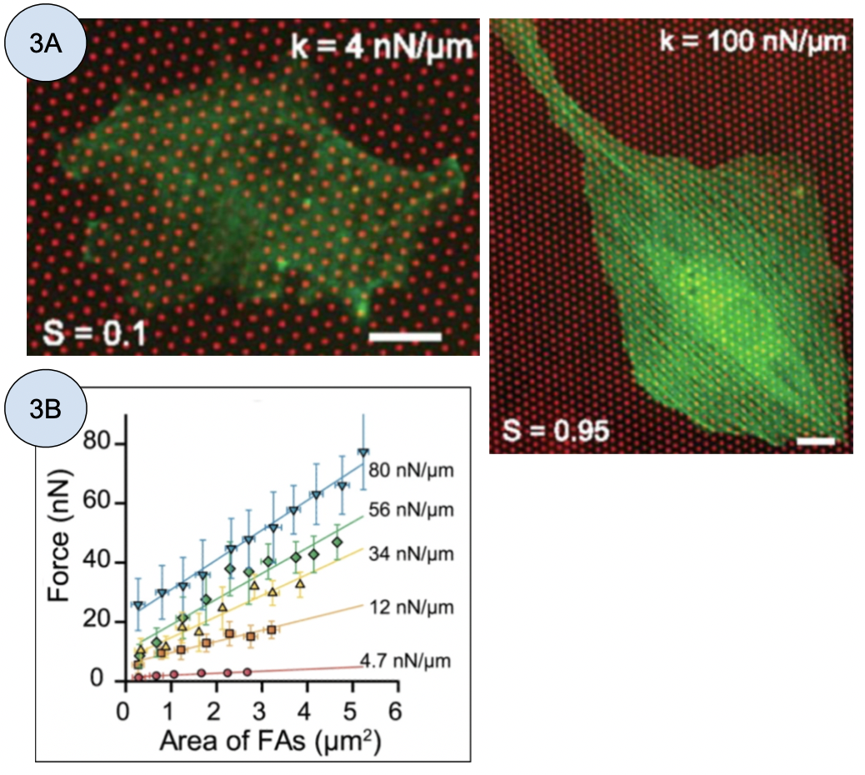
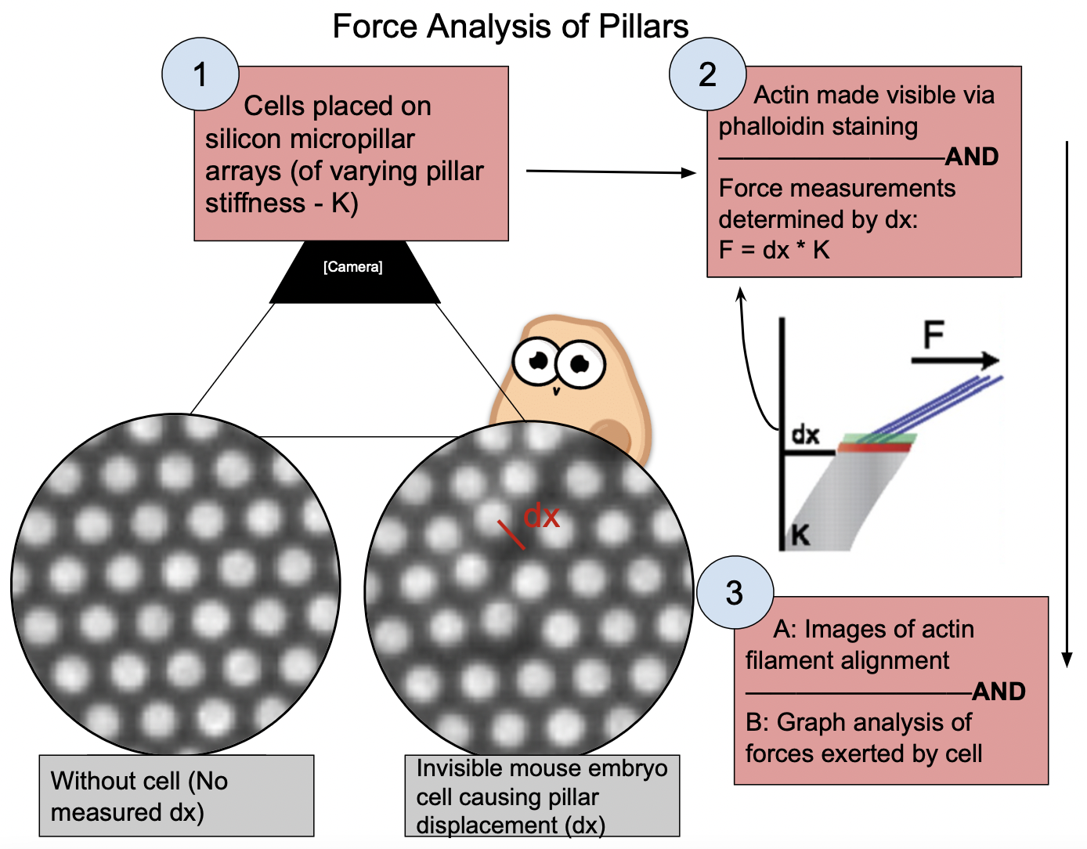


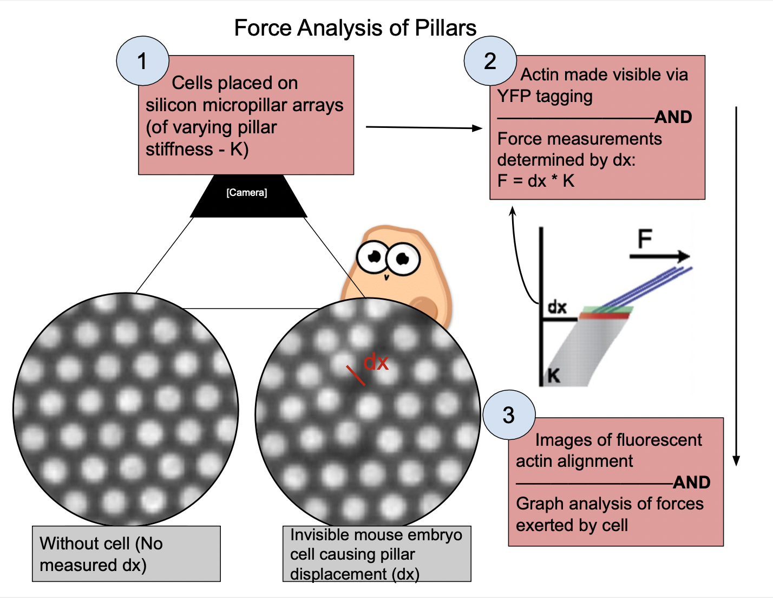
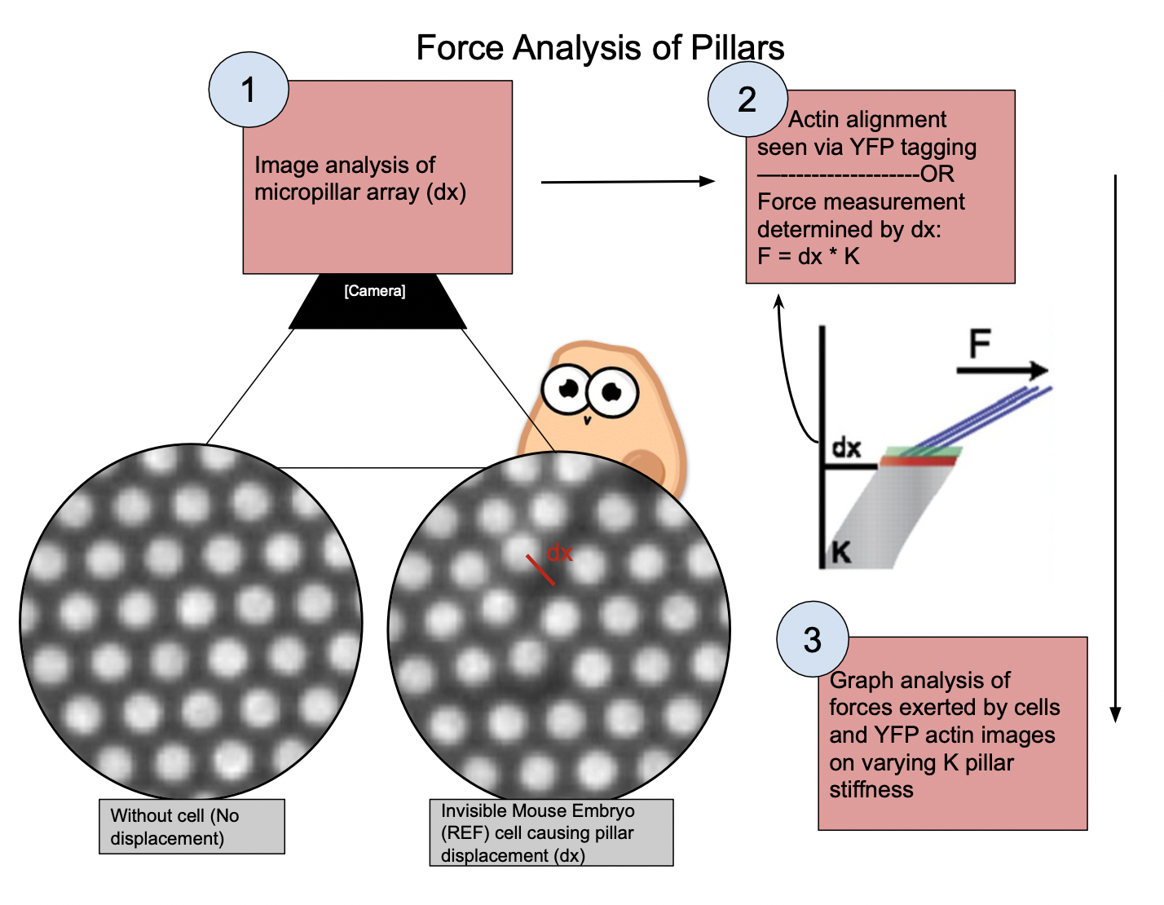

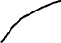
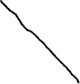
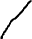
Evidence of a large-scale mechanosensing mechanism for cellular adaptation to substrate stiffness (Durotaxis)
Cole Saucier, Northeastern University, Boston MA
Introduction
Results
Cells attach themselves to the environment through focal adhesions. The cell moves by pulling at these adhesions. Locally and physically affected integrin receptors induce focal adhesion growth. This growth was attributed to the sole determinant of traction force. How other qualities of the cytoskeleton including actin fibers, relates to force exertion is not understood.
1. Traction forces, substrate stiffness, and actin stress fiber alignment are highly correlated.
2. Linear relationship found between traction force and area of focal adhesions (Fig 3B).
3. Higher substrate stiffness causes higher forces, this implies another mechanism
(Fig 3B).
4. Pillar displacement speed is constant of 1.3nm/s regardless of substrate stiffness.
Research Question and Hypothesis
How does the stiffness of the physical environment affect cell movement, forces, and other qualities of the cytoskeleton?
Hypothesis: A different, large-scale mechanism allows for cell adaption to environment stiffness.
Figure 3:
(A) Actin organization of same cell on two substrate stiffnesses.
(B) Cell traction force by focal adhesion area on several substrate stiffnesses.
Methods
Conclusions and future directions
Cell migration is not only determined by focal adhesion size, but also by large-scale mechanical feedback through the reorganization of actin stress fibers.
Actin stress fibers act as a force sensor which transmit mechanical tension to adhesions. These fibers clearly respond as force adaption of cell.
One problem: Article mentions other elastic properties having impacts on traction force and other cellular properties. However they do not test these metrics.
Think About
Presenting
Your Methods
in the format
of a figure
Literature Cited
1 Khare, S. M., Awasthi, A., Venkataraman, V. & Koushika, S. P. Colored polydimethylsiloxane micropillar arrays for high throughput measurements of forces applied by genetic model organisms. Biomicrofluidics 9, 014111, doi:10.1063/1.4906905 (2015).

